Slide 1








HOW TO USE THIS SLIDE DECK
This slide deck was designed as part of a collaborative project between the University of Utah and the Utah Recreation and Parks Association. This project showed that parks and recreation professionals know that they are contributing to health and wellness, but that it can be difficult to communicate these benefits to city leaders, elected officials, and the public. Many professionals felt that they do not have access to the relevant evidence to communicate the health benefits of their work.
We developed this slide deck to help parks and recreation professionals communicate about the health benefits of parks and recreation. There are three main sections in this slide deck:
  The Health Benefits of Parks and Recreation According to Research
  The Downstream Economic Benefits of Parks and Recreation: Evidence-Based Estimates
  Our Agency, Our Impact: How We Are Creating a Healthier Community
Keep in mind that this presentation is meant to be customized! You can use any or all of these slides to suit your presentation needs. Feel free to change the order of slides, delete slides, add slides, or make other changes to meet your needs. Some slides can be used as they are, while others need to be edited to apply to your own community. See the next slide for more information.

Slide 2
HOW TO USE THIS SLIDE DECK
As previously noted, there are three main sections in this slide deck:
The Health Benefits of Parks and Recreation According to Research
The Downstream Economic Benefits of Parks and Recreation: Evidence-Based Estimates
Our Agency, Our Impact: How We Are Creating a Healthier Community
The first two sections are based on research evidence. The slides in this section do not need to be edited to be used, except for slide 15. You can use them as they are, or you can copy and paste one or more slides into your own presentation. If you DO choose to edit these slides, make sure it is clear which information was drawn from research evidence and which information comes from other sources (from your participants or community members, for example).
All slides in the last section, Our Agency, Our Impact must be edited before use. These are template slides that allow you to insert information on your own agency and community. These slides can help you tell the story of how your agency is impacting health. You can use these slides to fill in information on your department’s mission, the status of health conditions in your community (e.g., how prevalent is diabetes?), who you serve, what facilities/programs you run, and more!

Slide 3
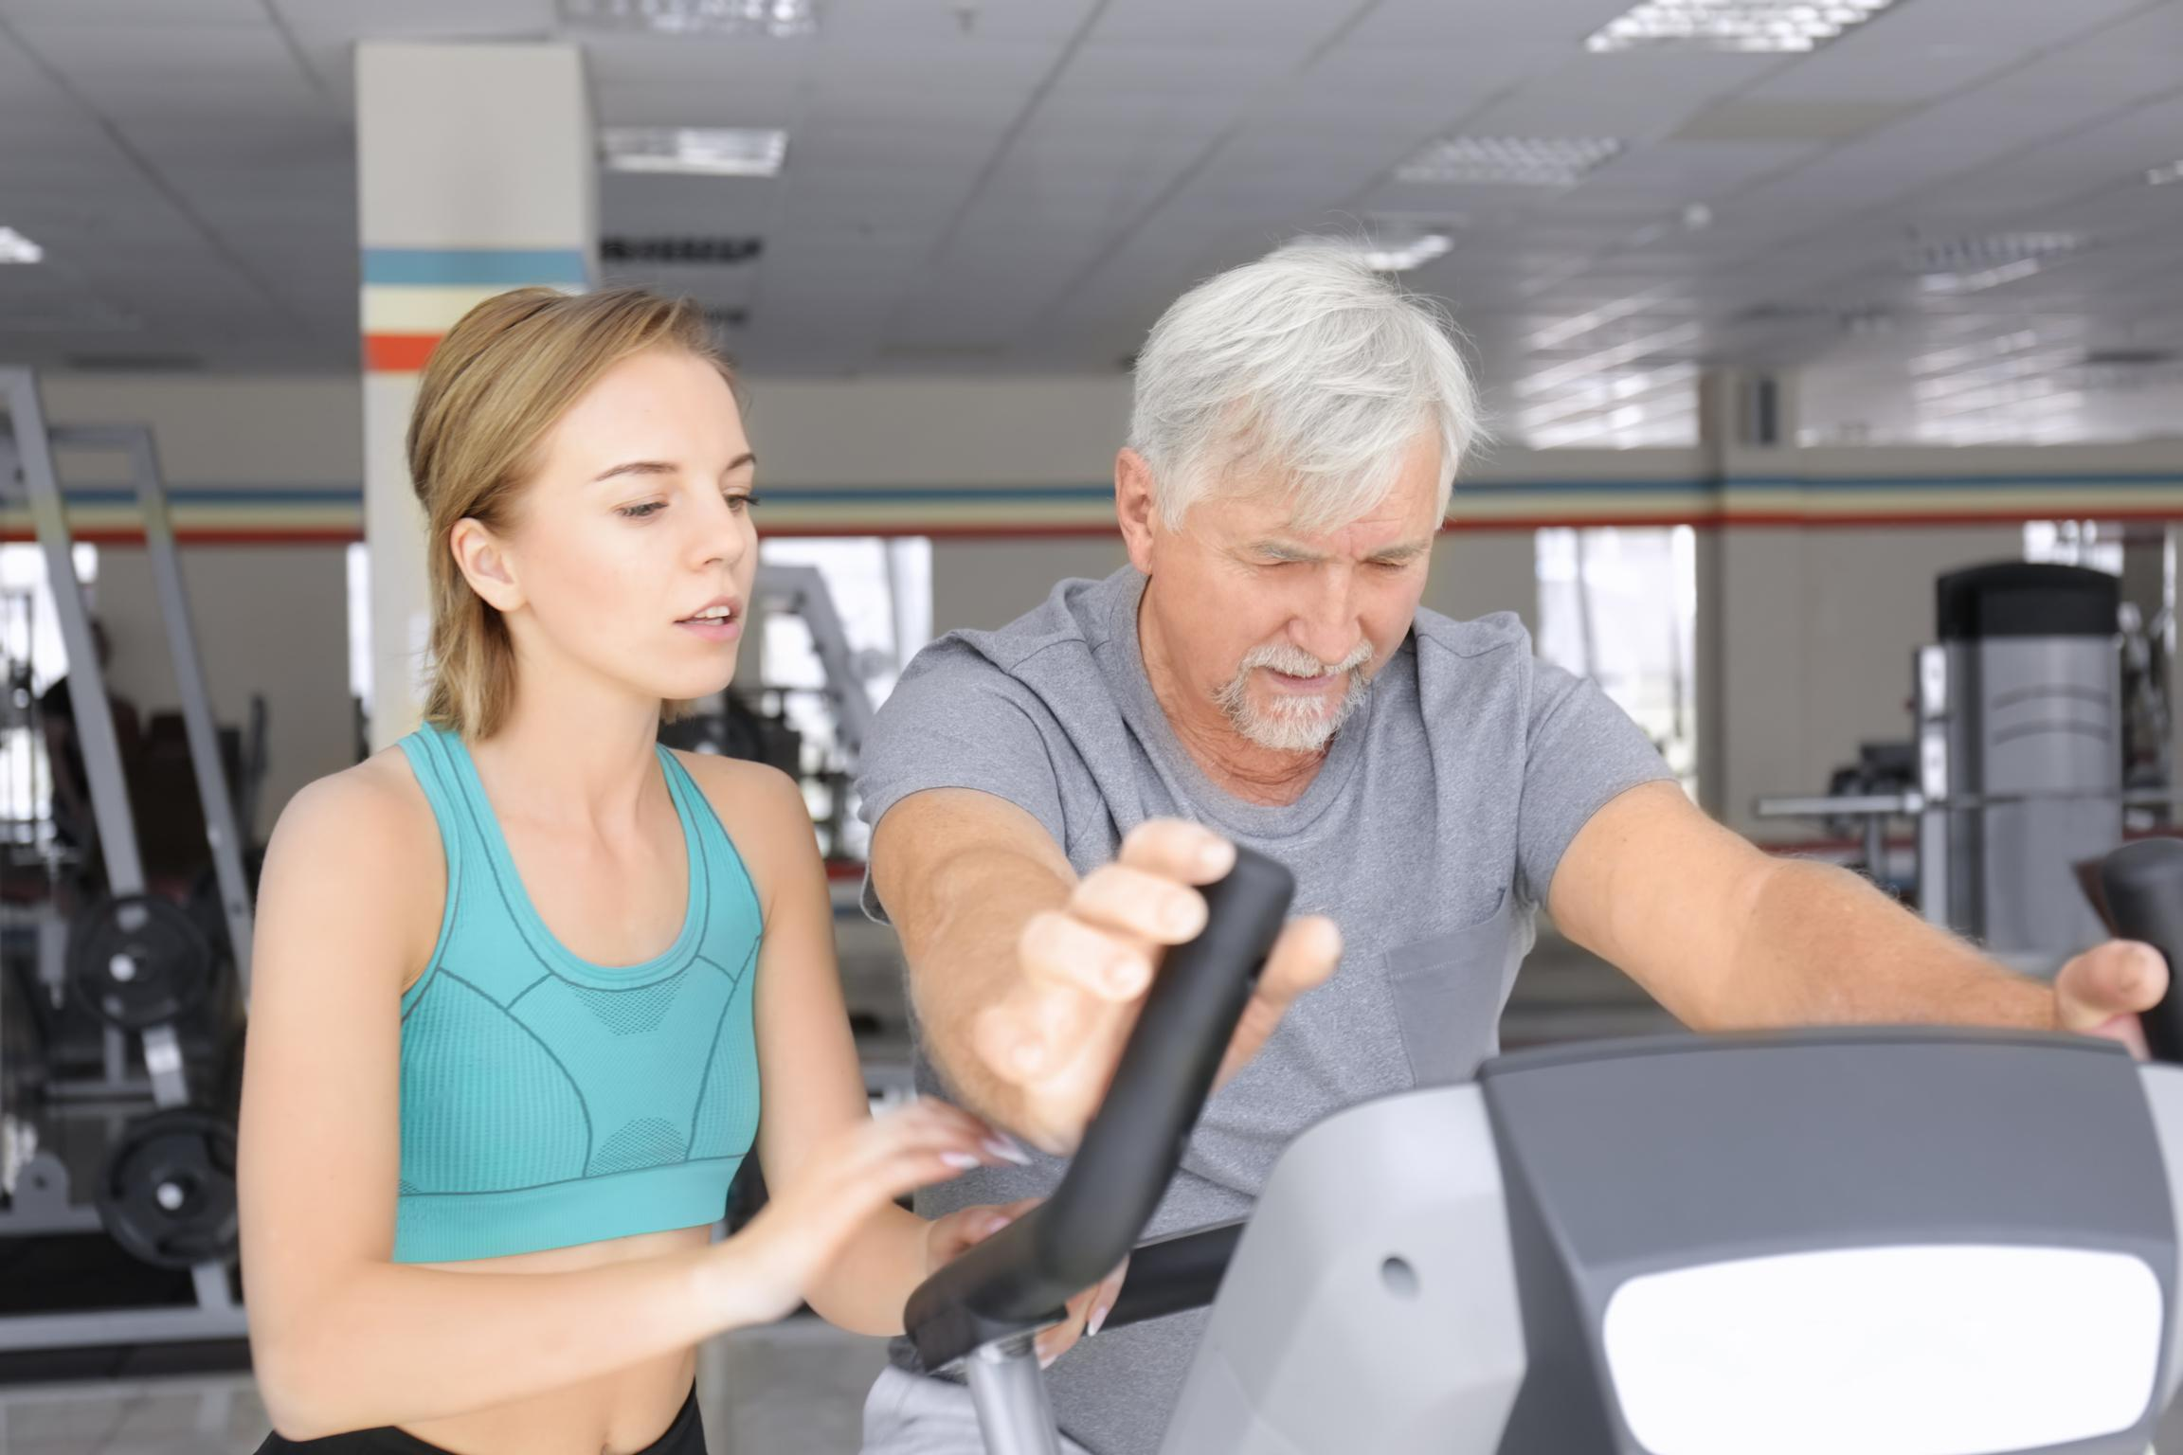


Health Benefits of Parks & Recreation
your department here

Slide 4
THE HEALTH BENEFITS OF PARKS AND RECREATION
ACCORDING TO RESEARCH

Slide 5

What Is Health & Why Does It Matter?
Health is the state of overall physical, mental, and social well-being that enables individuals to actively participate in and enjoy recreational activities, maintain functional independence, and contribute positively to their community.
Evidence suggests that parks and recreation agencies provide meaningful opportunities for participants to advance their health and wellness through provision of programs, maintenance of facilities, and stewardship of natural spaces.

Slide 6

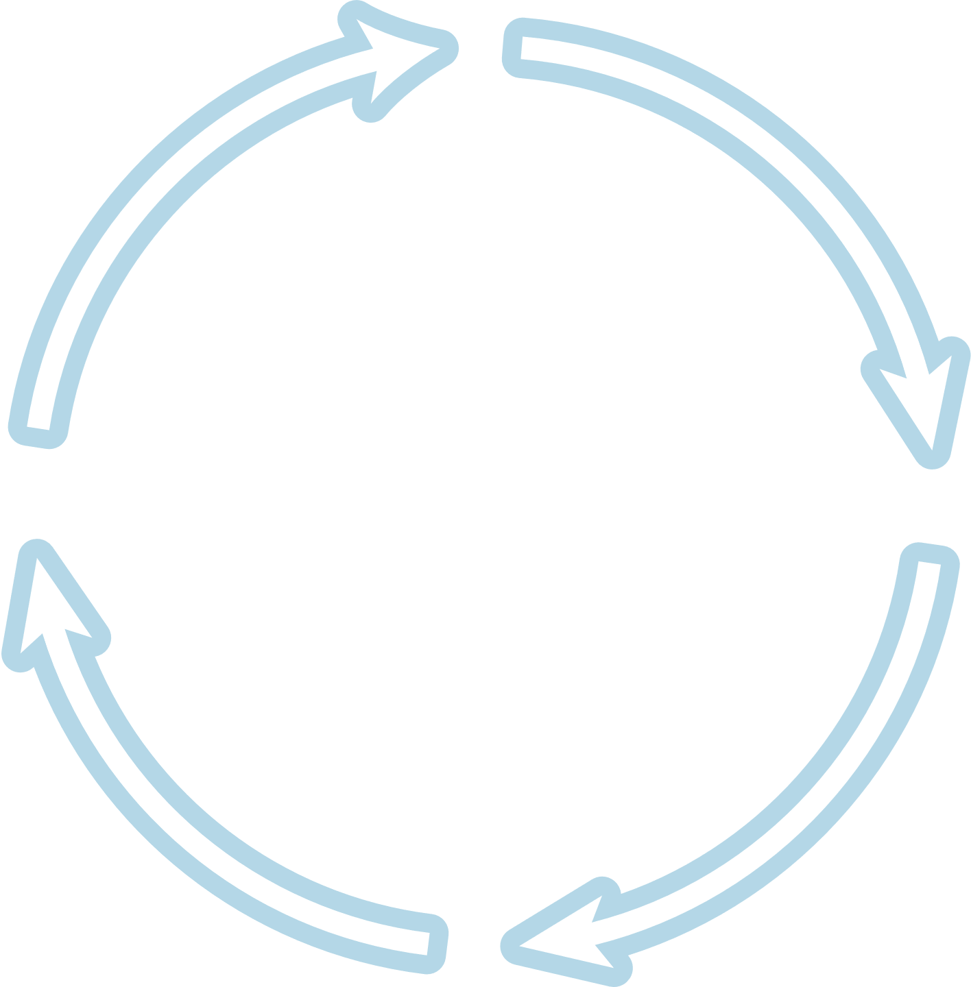




  Physical activity
  Healthy habits
  Disease prevention
  Longevity
  Health knowledge
  Reduced stress
  Mental restoration
  Improved mental health
  Emotion regulation skills
The Wellness Wheel
PHYSICAL WELLNESS
EMOTIONAL WELLNESS
  Social connectedness
  Sense of belonging
  Formation of friendships
  Spending time with others
  Community trust
  Skill development
  Personal growth and goal-setting
  Discovery of new interests
  Improved cognitive functioning (e.g., memory, attention)
SOCIAL WELLNESS
INTELLECTUAL WELLNESS
Wellness Benefits of Parks and Rec
Understanding How Parks and Recreation Contribute to the 8 Dimensions of Wellness
OCCUPATIONAL WELLNESS
ENVIRONMENTAL WELLNESS
  Meaningful employment
  Identification of hobbies
  Using unique talents
  Pursuit of work-life balance
  Access to safe and stimulating spaces
  Exposure to nature
  Mitigation of environmental health risks
SPIRITUAL WELLNESS
FINANCIAL WELLNESS
  Finding a sense of purpose
  Contributing to the common good
  Exploring culture and community
  Free and low-cost spaces and activities
  Healthcare savings
Note: This Wellness Wheel is adapted from the Substance Abuse and Mental Health Services Administration.

Slide 7
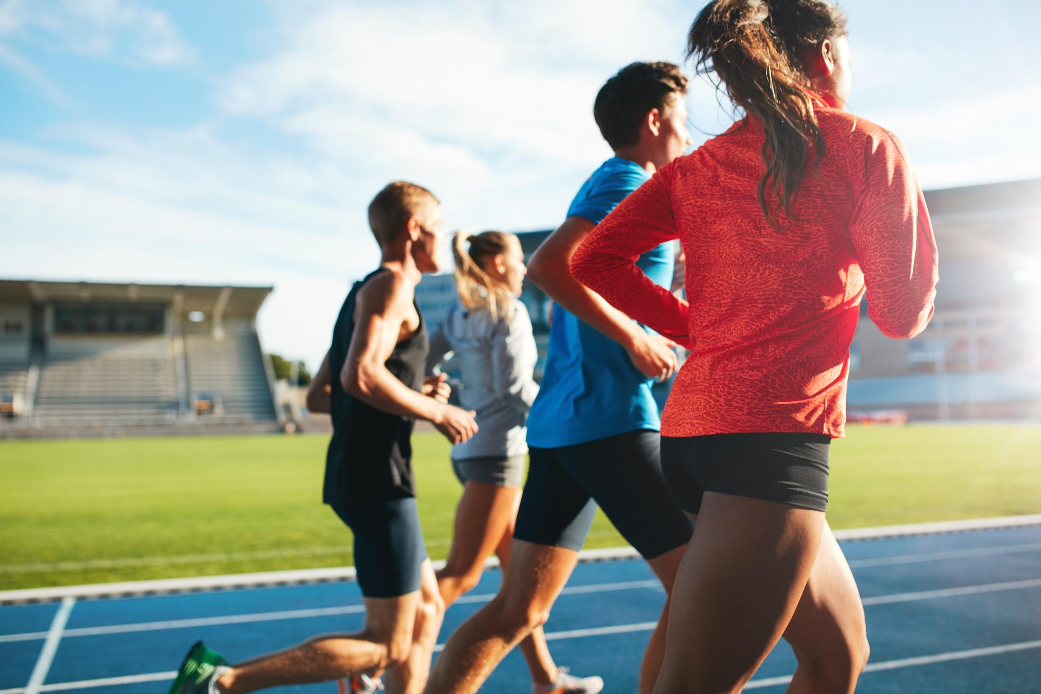
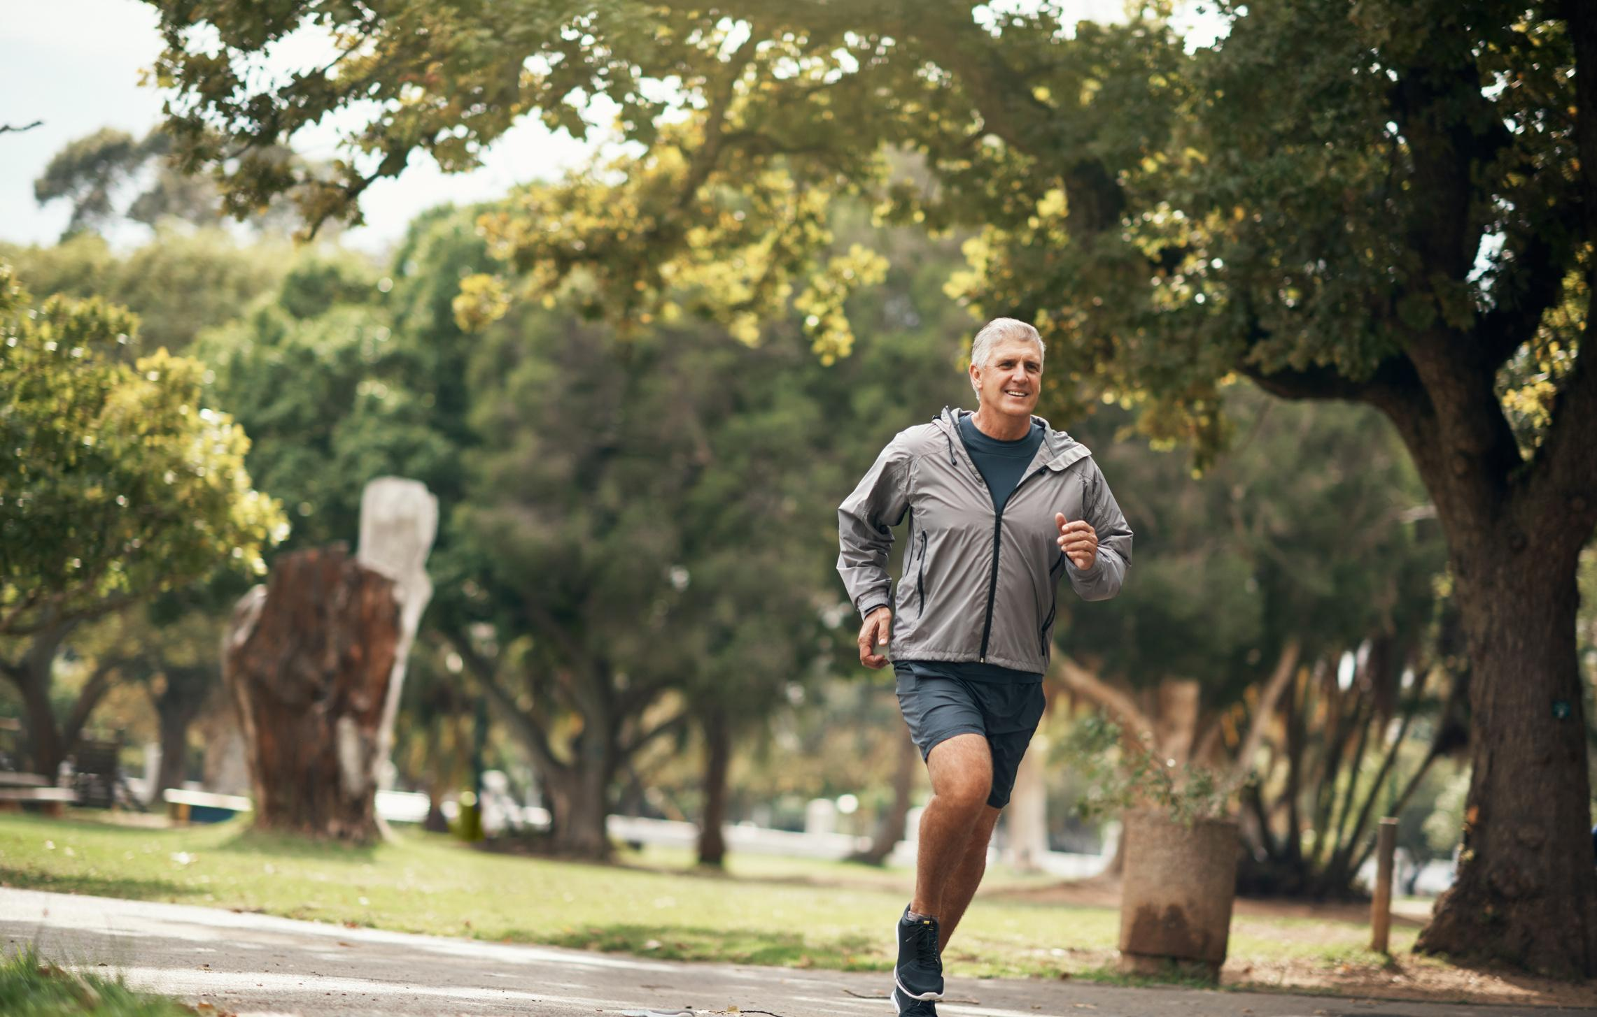


Health & Wellness Benefits of Physical Activity
INDIVIDUAL BENEFITS
COMMUNITY BENEFITS
  Cardiovascular health
  Weight management & metabolism
  Mental health
  Improved immune system
  Bone and joint health
  Reduced healthcare costs
  Increased work productivity
  Community well-being
  Economic activity
  Environmental health
Parks and Recreation agencies create opportunities for people to engage in physical activity through maintenance of public spaces, low-cost facilities, and engaging programming
KEY REFERENCES
Anderson & Durstine, 2019
Regina Guthold et al. 2020
Posadzki et al. 2020
Warburton, Darren E.R., Bredin, Shannon S.D. 2017

Slide 8
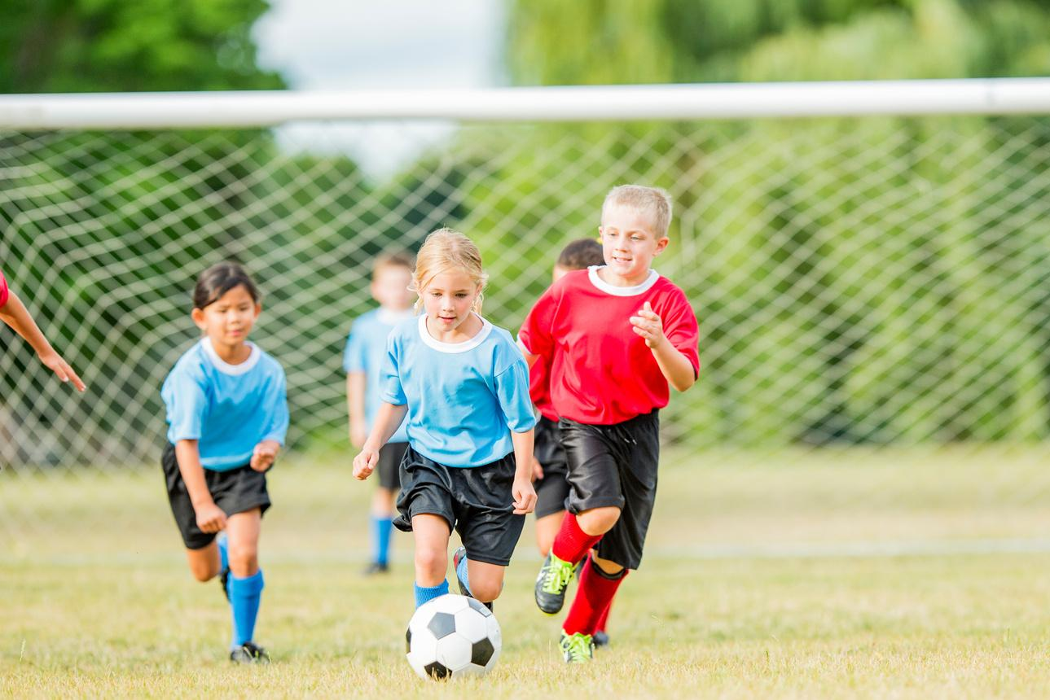

Health & Wellness Benefits of Youth Sports
INDIVIDUAL BENEFITS
COMMUNITY BENEFITS
  Physical fitness
  Teamwork & social skills
  Discipline & time management
  Resilience & perseverance
  Healthy lifestyle habits
  Leadership skills
  Emotional regulation
  Lifetime leisure time physical activity enjoyment
  Academic performance
  Social cohesion & community engagement
  Community pride
  Community safety & reduced delinquency
  Facilities & infrastructure improvement
  Healthier population
  Education & skill development
  Economic impact
  Cultural diversity & inclusion
  Community volunteerism
Through youth sports programming, Parks and Recreation agencies create positive, fun, & productive leisure opportunities for young people.
KEY REFERENCES
Bruner et al. 2021, Howie et al. 2020, Cronin & Allen 2018

Slide 9
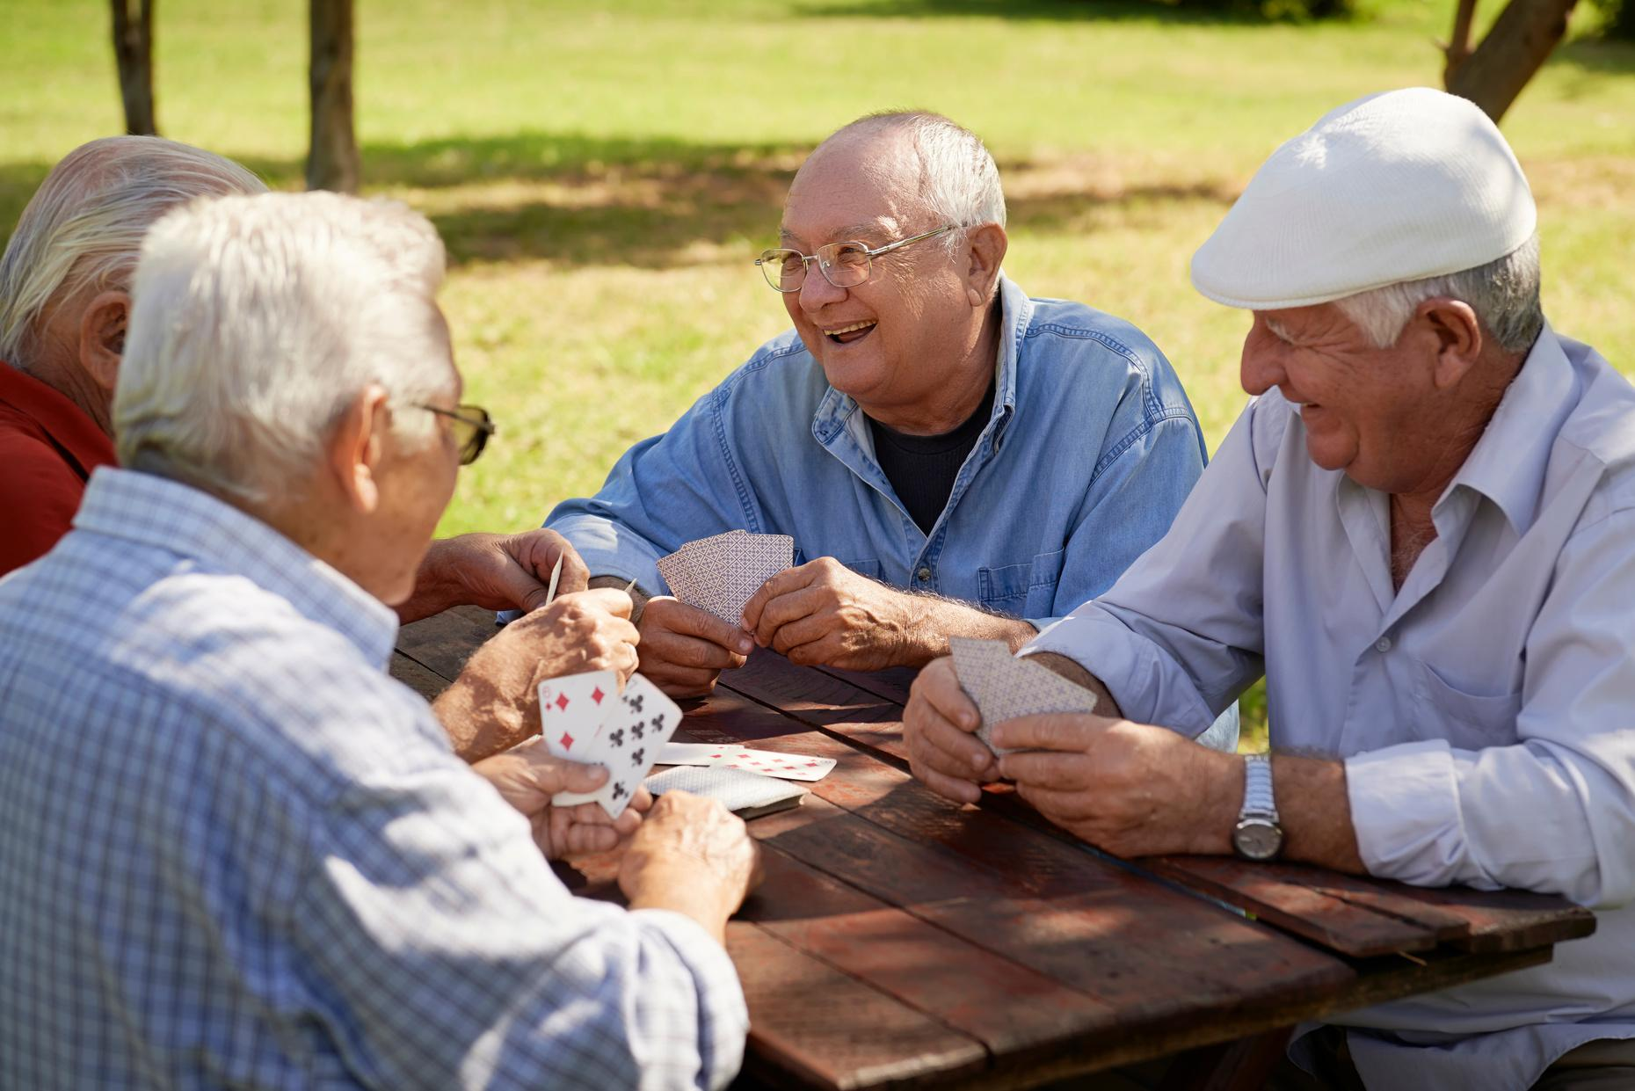
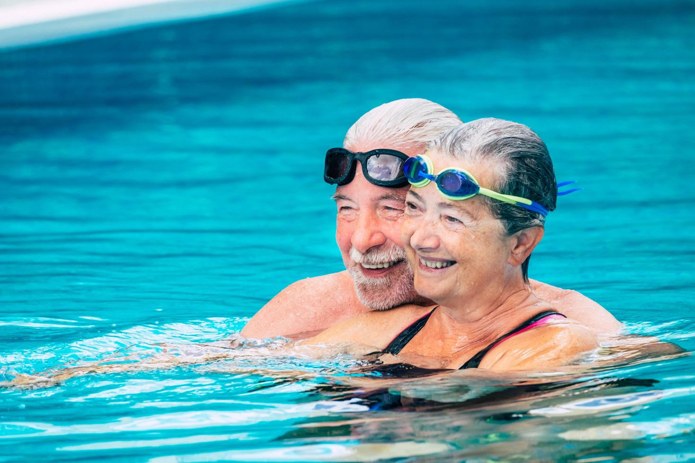



Health & Wellness Benefits of Social Connection for Aging Populations
Social isolation affects a significant portion of the older adult population and is a serious health concern.
Parks and recreation agencies combat social isolation and its related health effects by creating opportunities for:
  Meaningful engagement
  Shared activities involving increased movement
  Connection in greenspace
  Peer support & empowerment
  Technology integration
  Structured socialization
  Intergenerational connections
KEY REFERENCES
Bustamante et al. 2022, Danielsen et al. 2021, Barragan 2021, Heckel et al. 2023

Slide 10
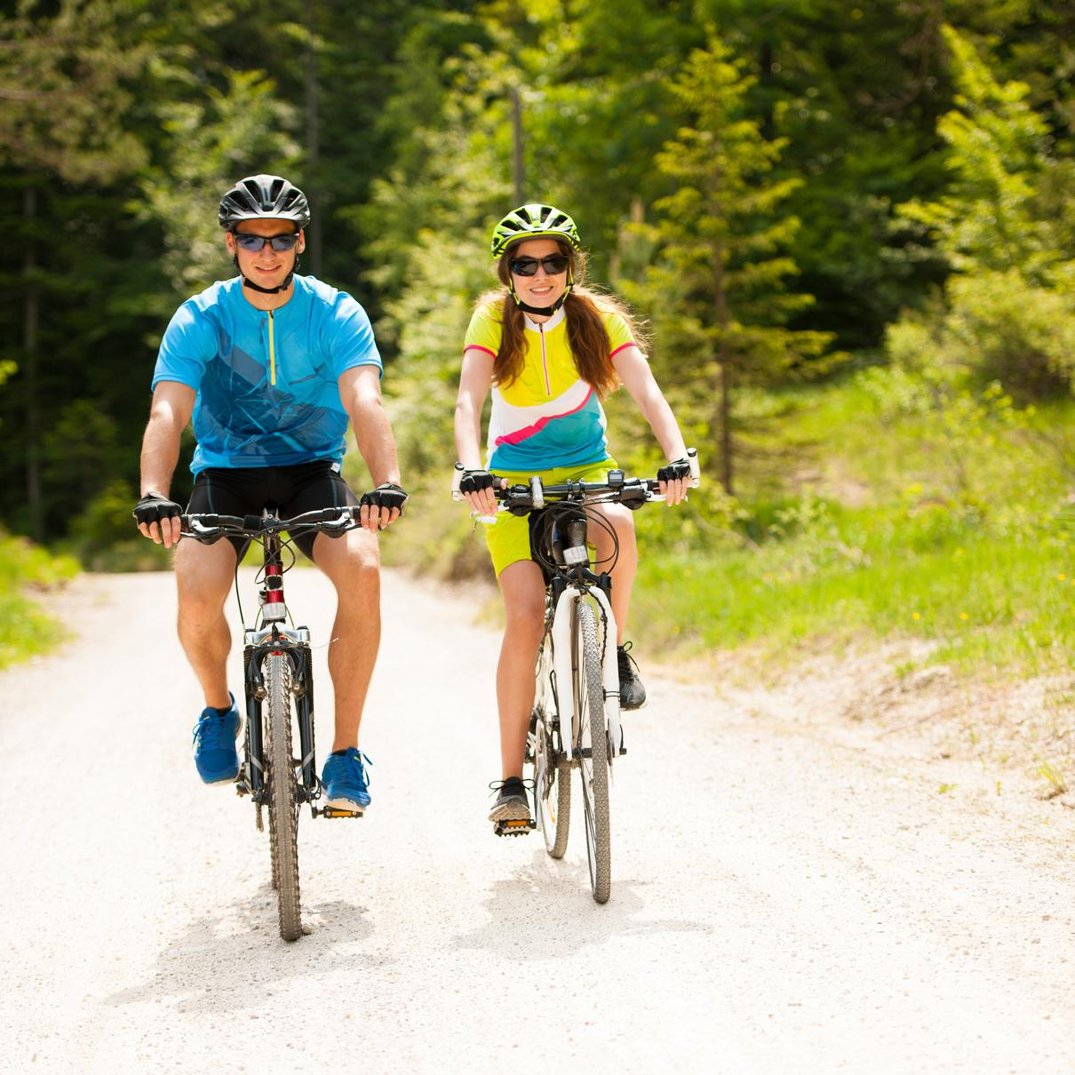
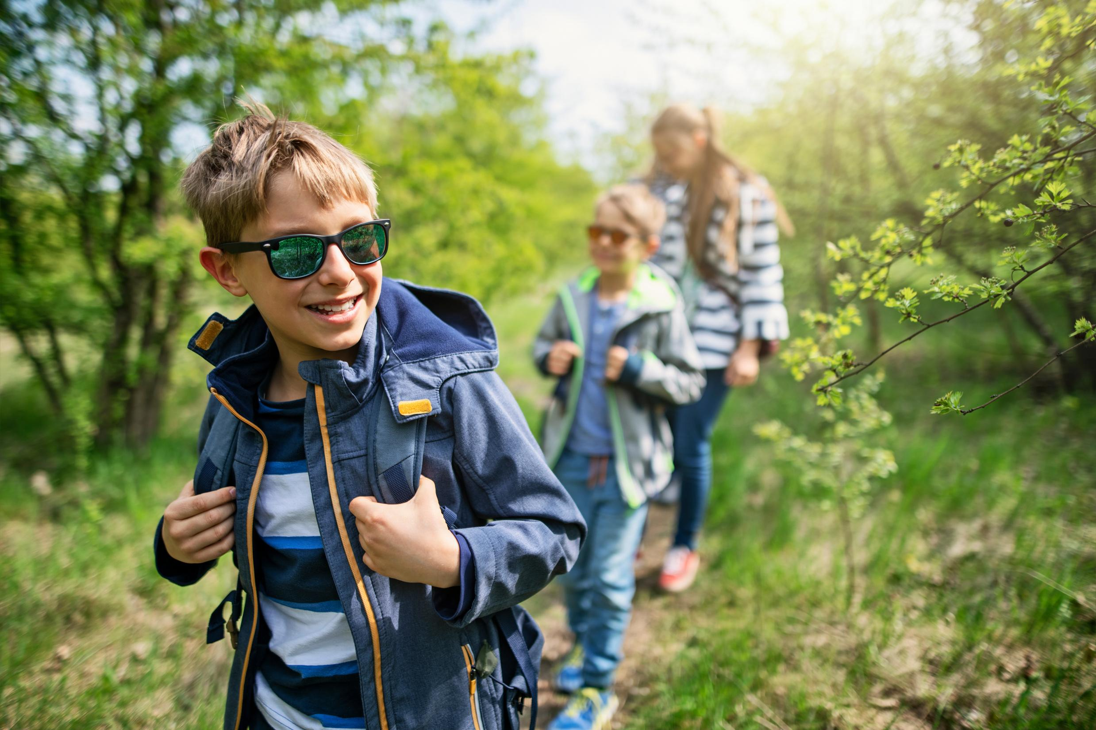
Health & Wellness Benefits of Outdoor Recreation
INDIVIDUAL BENEFITS
COMMUNITY BENEFITS
  Stress reduction & mental health improvements
  Social connection
  Connection with nature
  Physical activity
  Positive youth development
  Economic growth
  Tourism promotion
Outdoor recreation continues to grow in popularity, with time in nature linked to many positive health benefits.
By providing opportunities for outdoor recreation, parks and recreation agencies can promote individual and community wellness.
KEY REFERENCES
Lackey et al. 2021, Fagerholm et al. 2021, Jackson et al. 2021

Slide 11

Health & Wellness Benefits of Public Investment in Parks and Recreation
Parks & recreation spending is associated with increased self-reported health in the U.S.
Increased parks & recreation spending is associated with decreased mortality rates.
Access to parks & recreational facilities decreases healthcare costs for adults in the U.S.
KEY REFERENCES
Mueller, Park, Mowen 2019, Sato et al. 2019, Davies et al. 2019, Keane et al. 2019

Slide 12
THE DOWNSTREAM ECONOMIC BENEFITS OF PARKS AND RECREATION
EVIDENCE-BASED ESTIMATES

Slide 13



Assessing the Economic Impacts of Parks and Recreation
Economic Impact
Cost-Benefit Analysis
Social Return on Investment
EVERY
SPENT ON PARKS & RECREATION
Measures the tangible economic benefits of parks and recreation, such as economic activity, tourism revenue, and jobs creation.
Measures the tangible economic benefits of parks and recreation relative to the up-front costs.
Measures the tangible and intangible economic benefits of parks and recreation relative to the up-front costs.
GENERATES
IN REVENUE
IN COST SAVINGS
IN SOCIAL RETURNS
This can include considering how investing in parks and recreation reduces costs in the long-run (such as healthcare spending)
SROI assigns monetary value to things like improved community health & well-being and enhanced environmental sustainability to provide a more holistic view of how parks and recreation improves the community.
KEY REFERENCES
King et al. 2014
Keane et al. 2019
Notes:
To read more on these different kinds of economic evaluation methods:
Economic Impact: https://cece.vt.edu/projects/EconomicImpact101.html
Cost-Benefit Analysis: https://online.hbs.edu/blog/post/cost-benefit-analysis
SROI: https://www.investopedia.com/ask/answers/070314/what-factors-go-calculating-social-return-investment-sroi.asp
SROI:

Slide 14


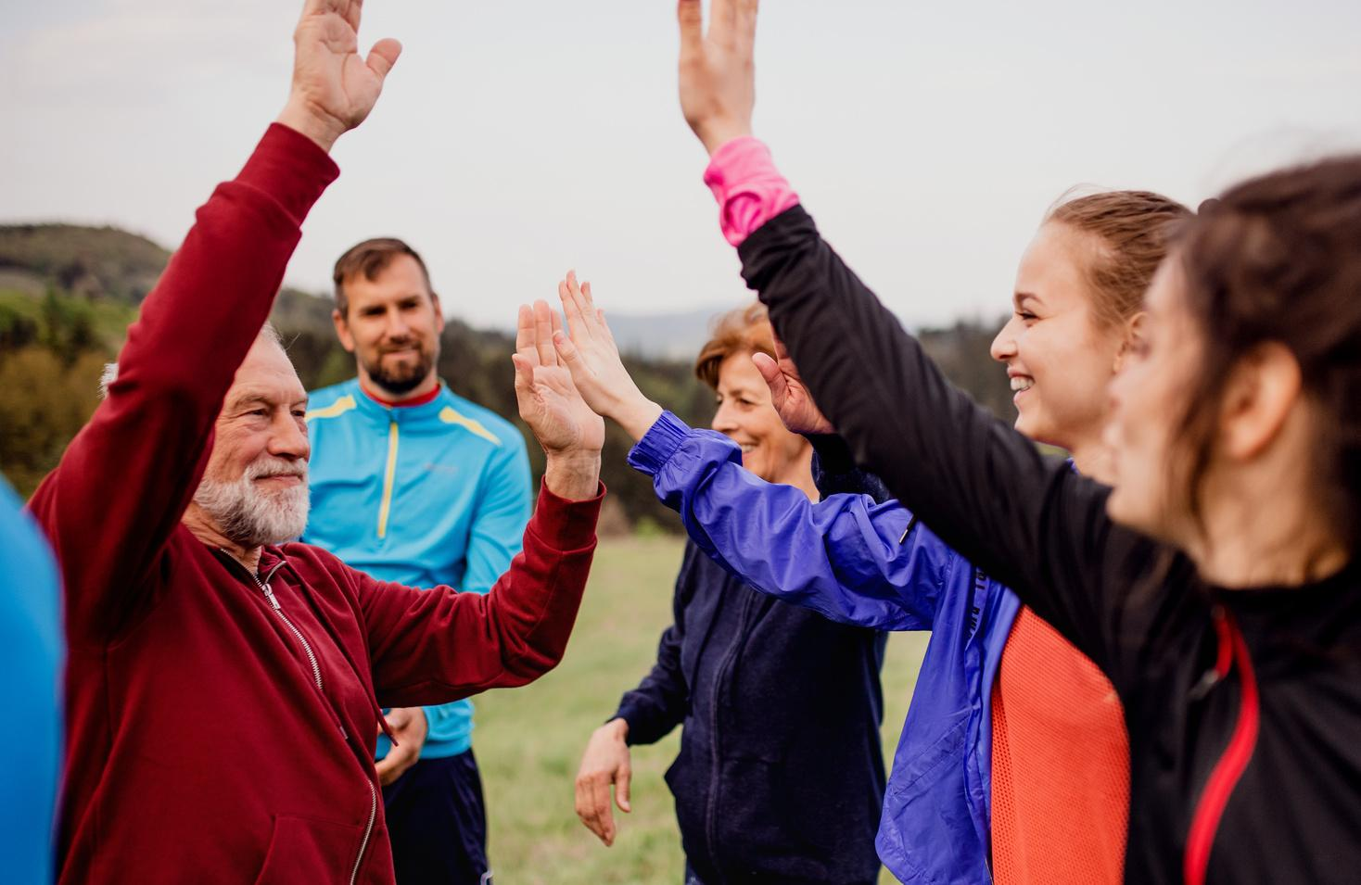



Estimated Economic Benefits of Parks and Recreation
In Utah, Local Parks and Recreation Agencies are estimated to generate
In the U.K.
EVERY
GENERATES
1.25 BILLION
IN ECONOMIC ACTIVITY, ADDED GDP, AND LABOR INCOME
nrpa.org/ParkEconReport
SPENT ON PARKS & RECREATION
IN SOCIAL RETURNS
In Florida, maintenance of local parks is estimated to generate
Davies et al. 2021
118 MILLION
While no one has developed an SROI calculator for Utah, the SROI framework helps illustrate the holistic downstream effects of parks and recreation spending.
IN HEALTHCARE COST SAVINGS
frpa.org

Slide 15
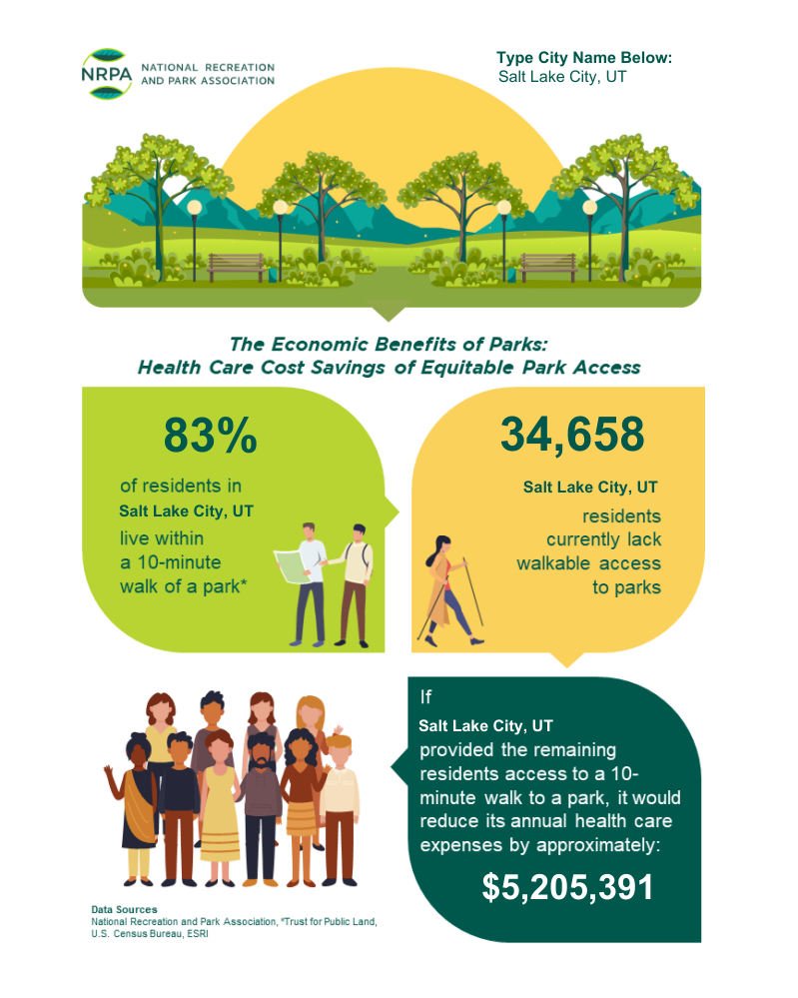
Estimated Health Care Cost Savings from Local Parks
nrpa.org
Notes:
This slide includes data from Salt Lake City. If you want to personalize it, input your city into this website (https://www.nrpa.org/publications-research/research-papers/the-health-benefits-of-parks-and-their-economic-impacts/2023-npra-the-health-benefits-of-parks/), screenshot the results, and include them in this slide.

Slide 16
OUR AGENCY, OUR IMPACT
HOW WE ARE CREATING A HEALTHIER COMMUNITY

Slide 17
YOU MUST EDIT THE FOLLOWING SLIDES BEFORE USE!
THE FOLLOWING SLIDES ARE TEMPLATES AND MUST BE EDITED PRIOR TO USE.
CHECK THE SPEAKER NOTES FOR ADVICE ON HOW TO FILL OUT THE TEMPLATES. DELETE ANY SLIDES YOU DO NOT PLAN TO USE.

Slide 18

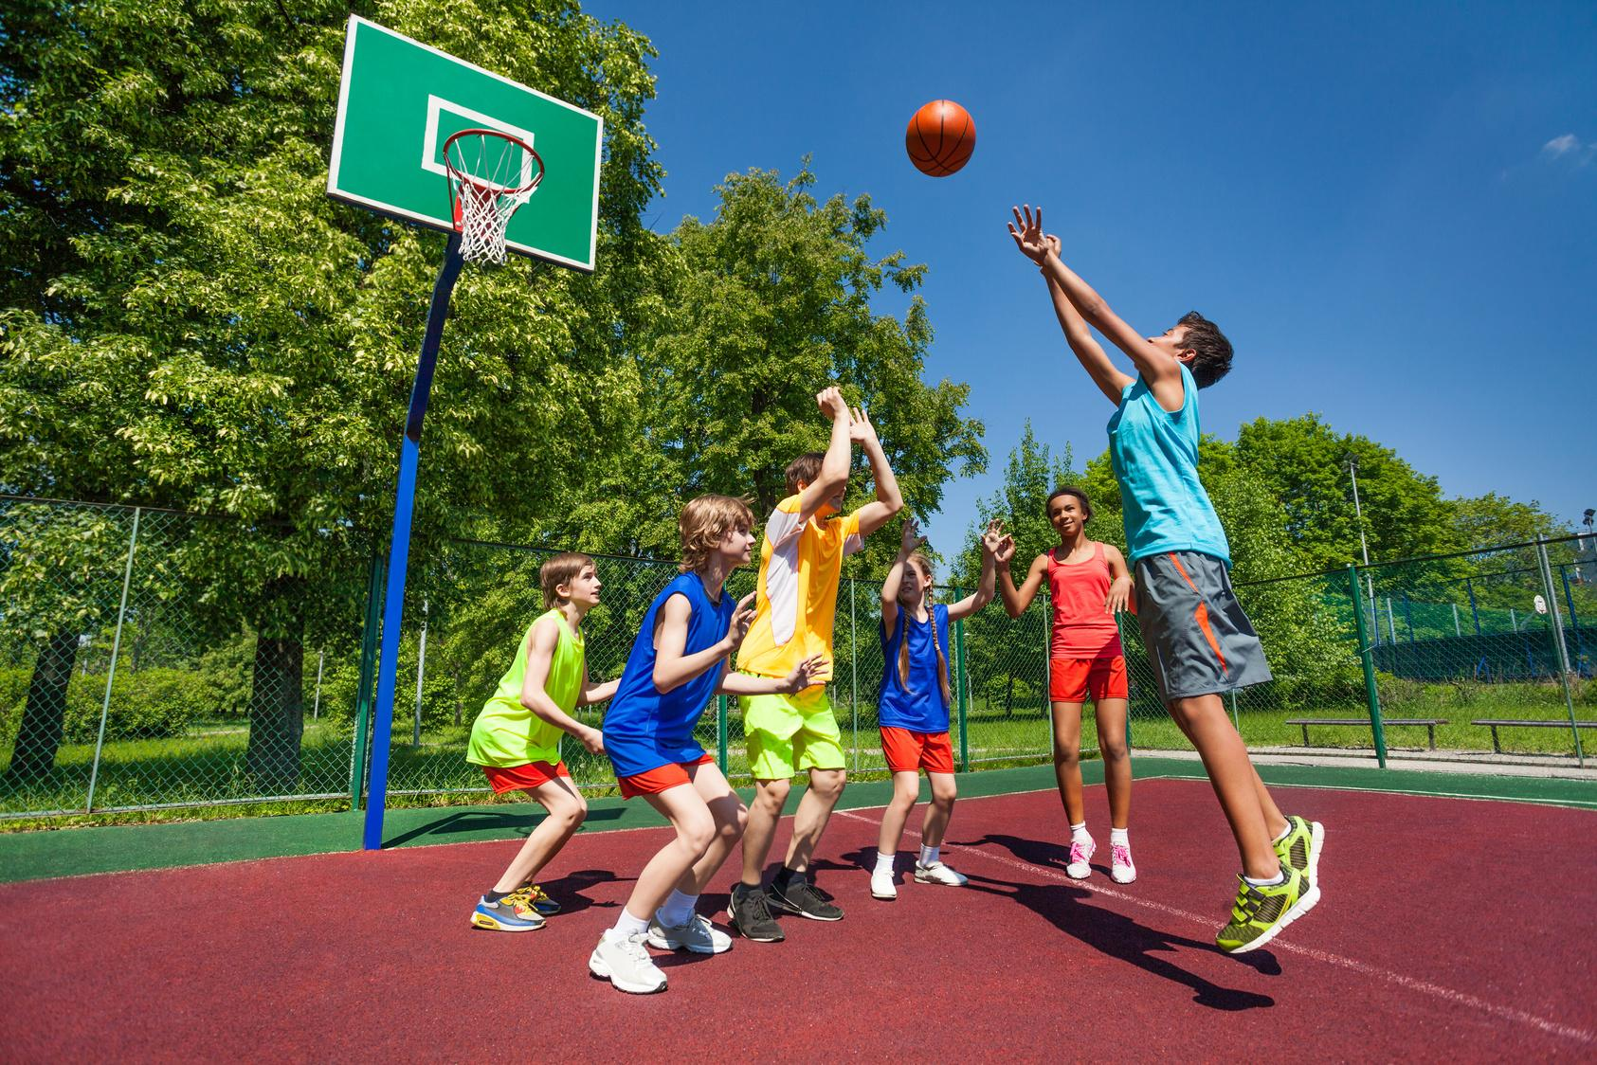


Our Vision & Mission
Our Vision
Our Mission
INSERT YOUR INFO HERE.
INSERT YOUR INFO HERE.
Notes:
Add information on your department or city’s vision and mission here.

Slide 19
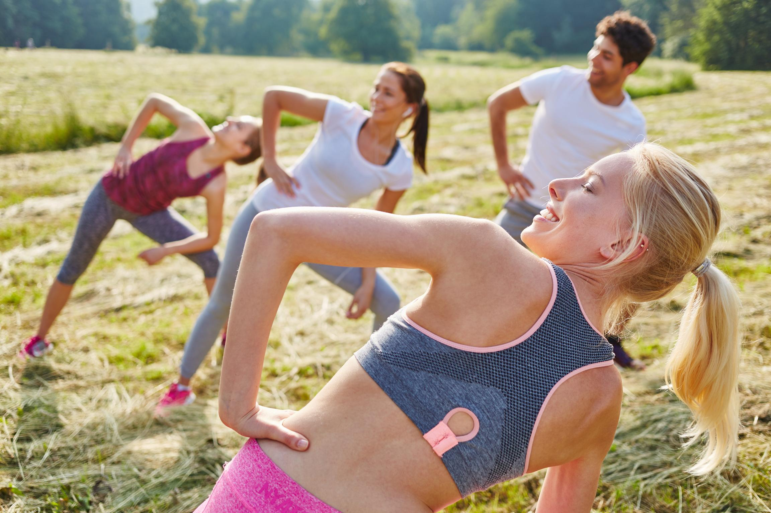

METRICS OF
IN
YOUR LOCATION HERE
Notes:
This is one of several slides where you can add information on your community’s health.
You may want to highlight health problems in your community that you are helping to address, such as diabetes. You could also choose to highlight ways that your community is healthy!
You can use the Dept of Health and Human Services Community Snapshot Report to find health statistics for your County or Small Area.
https://ibis.health.utah.gov/ibisph-view/community/snapshot/Builder.html
Select your community
Select your health indicators (you can choose to pull all indicators, or you can select a general category like Chronic Diseases)
Select additional information for your report
Submit the webpage, and you’ll have your report!

Slide 20
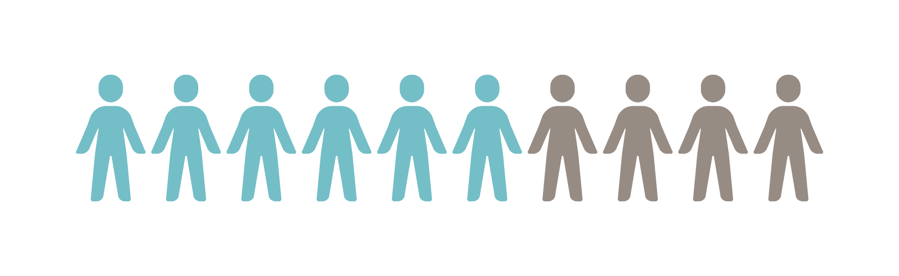

IN OUR COMMUNITY:
INSTANCES OF X IN X AMOUNT OF PEOPLE
YOUR EXPLANATION HERE:
citation
Notes:
This is one of several slides where you can add information on your community’s health.
You may want to highlight health problems in your community that you are helping to address, such as diabetes. You could also choose to highlight ways that your community is healthy!
You can use the Dept of Health and Human Services Community Snapshot Report to find health statistics for your County or Small Area.
https://ibis.health.utah.gov/ibisph-view/community/snapshot/Builder.html
Select your community
Select your health indicators (you can choose to pull all indicators, or you can select a general category like Chronic Diseases)
Select additional information for your report
Submit the webpage, and you’ll have your report!

Slide 21
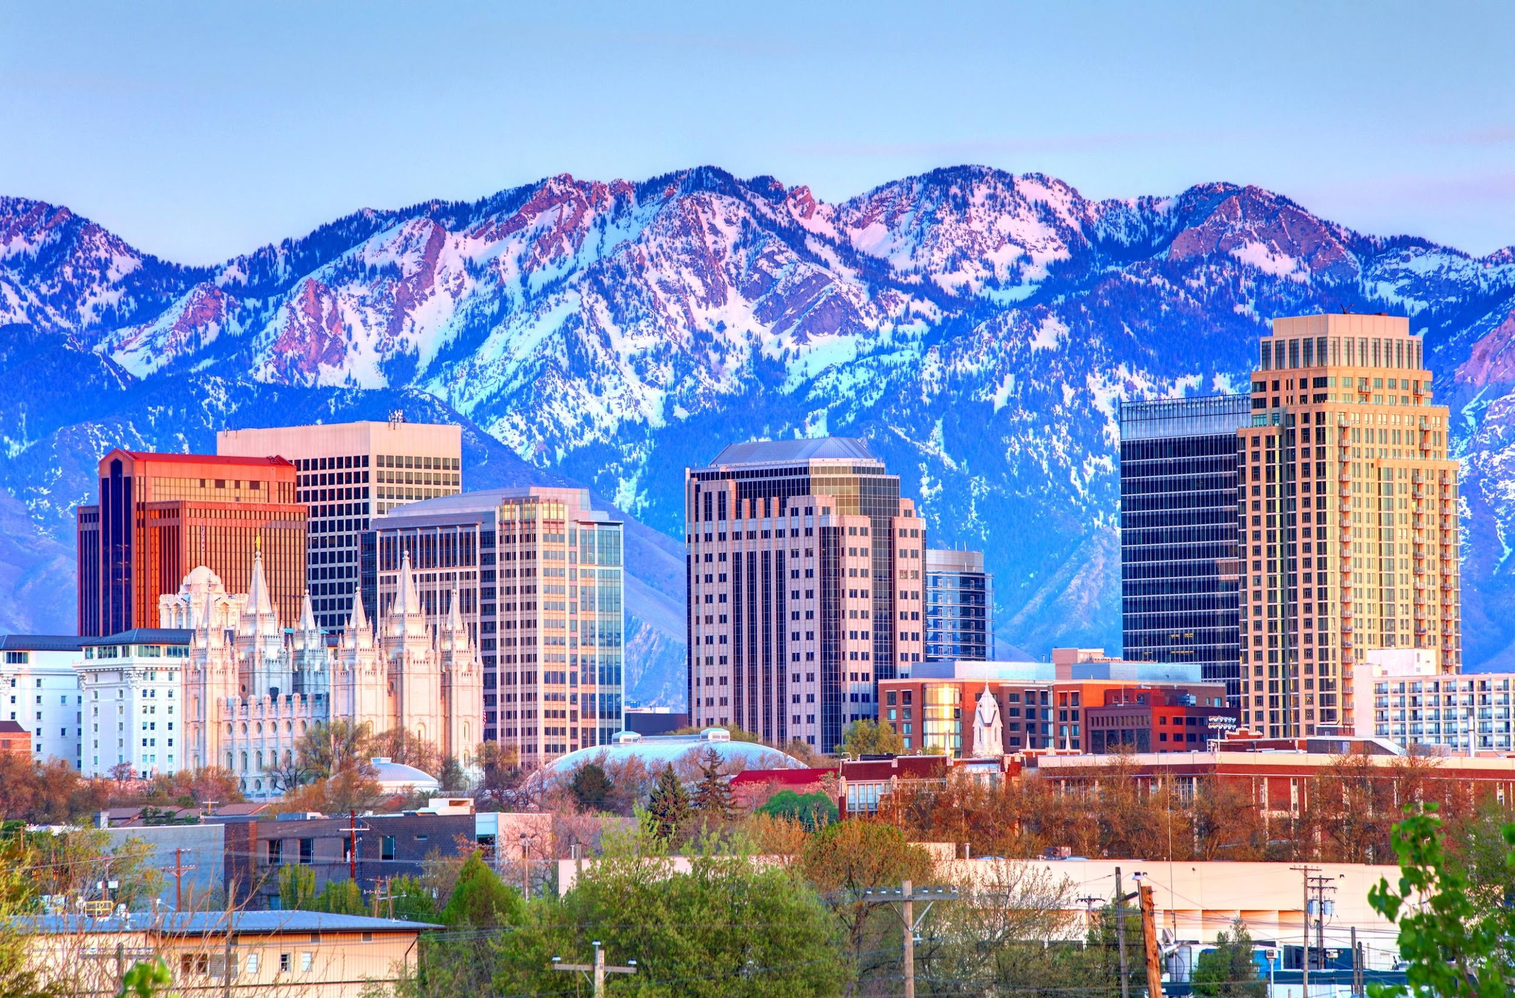
Health Metrics:
INSERT YOUR METRICS HERE.
66%
84%
97%
Recovery
Recovery
Recovery
Notes:
This is one of several slides where you can add information on your community’s health.
You may want to highlight health problems in your community that you are helping to address, such as diabetes. You could also choose to highlight ways that your community is healthy!
You can use the Dept of Health and Human Services Community Snapshot Report to find health statistics for your County or Small Area.
https://ibis.health.utah.gov/ibisph-view/community/snapshot/Builder.html
Select your community
Select your health indicators (you can choose to pull all indicators, or you can select a general category like Chronic Diseases)
Select additional information for your report
Submit the webpage, and you’ll have your report!

Slide 22
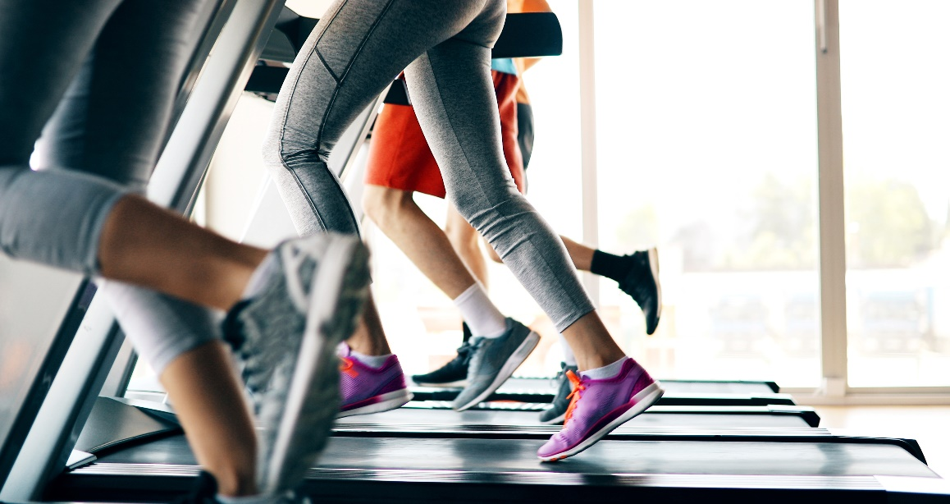
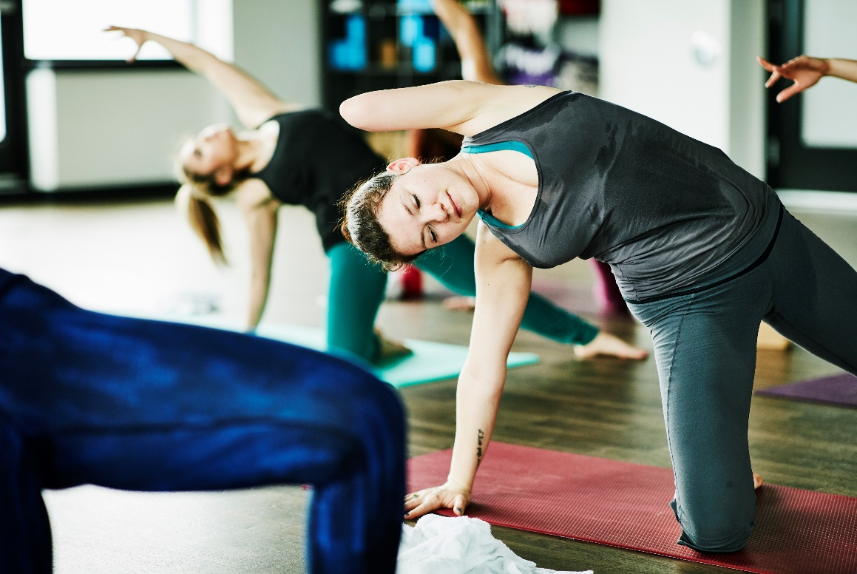
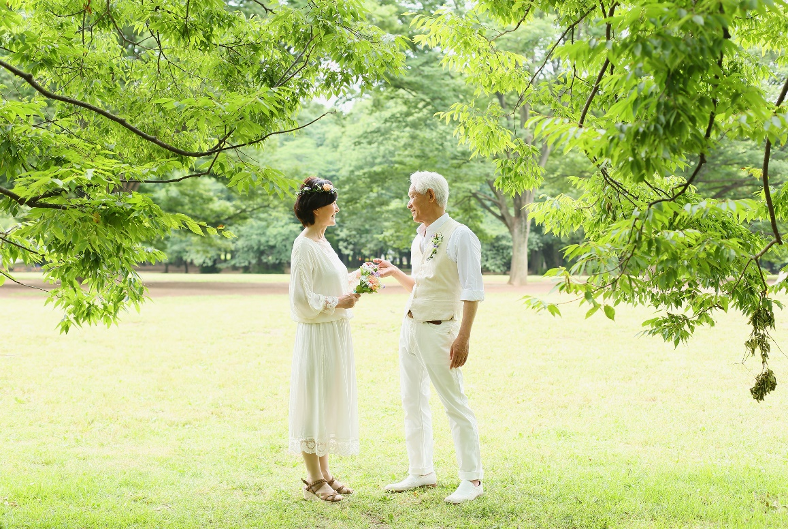
How We Contribute to Community Health
Facilities
  Example 1
  Example 2
Programs
  Example 1
  Example 2
  Example 3
Parks
  Example 1
  Example 2
Notes:
Add information on the types of programs, facilities, and spaces you provide that help promote health in your community.
Add your own pictures if desired.

Slide 23

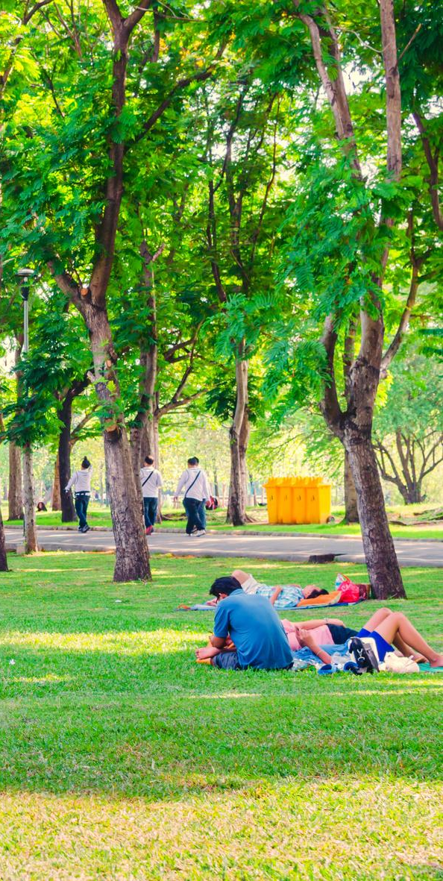
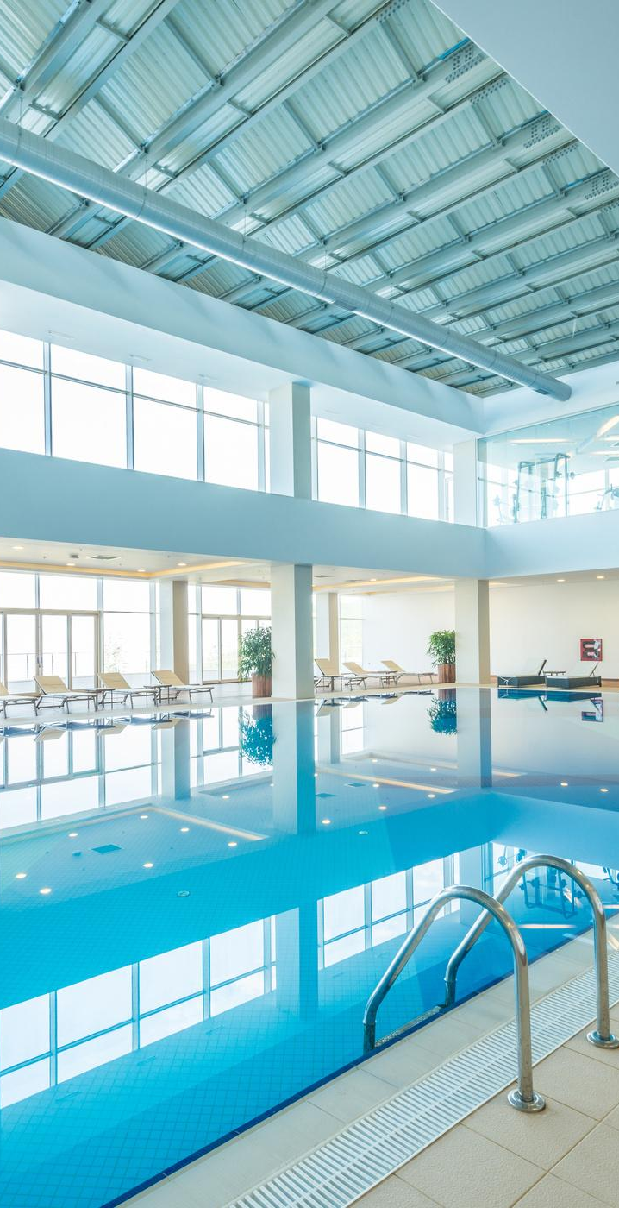
User days for our facilities:
01
02
Facility One
Facility Two
YOUR INFO HERE.
YOUR INFO HERE.
Notes:
Add information on user days for your facilities (if you have facilities).

Slide 24
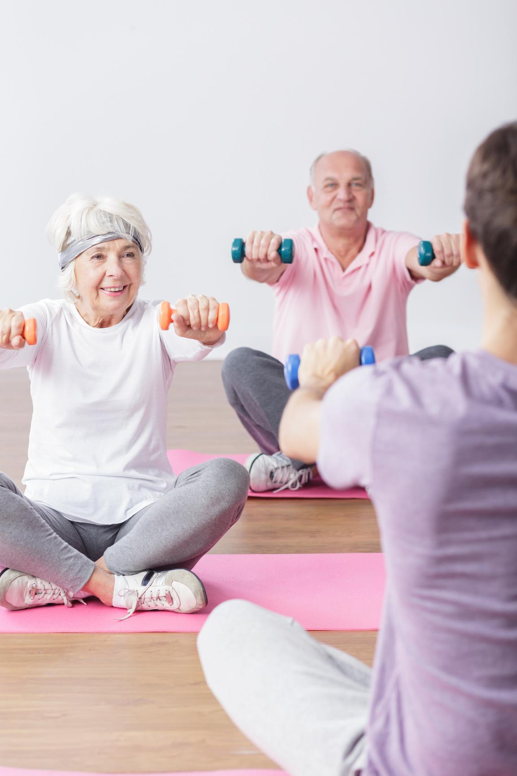
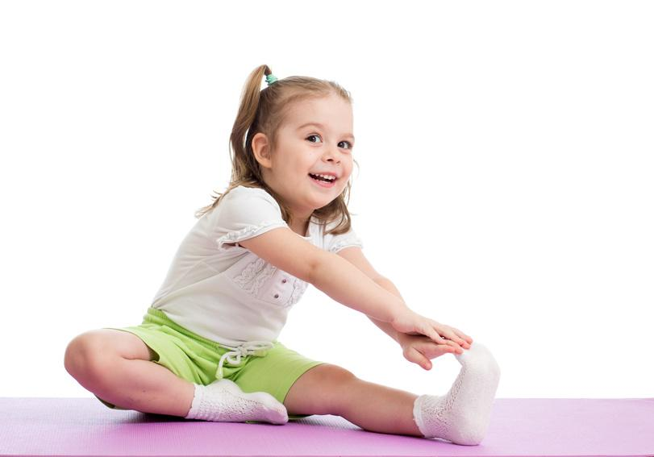

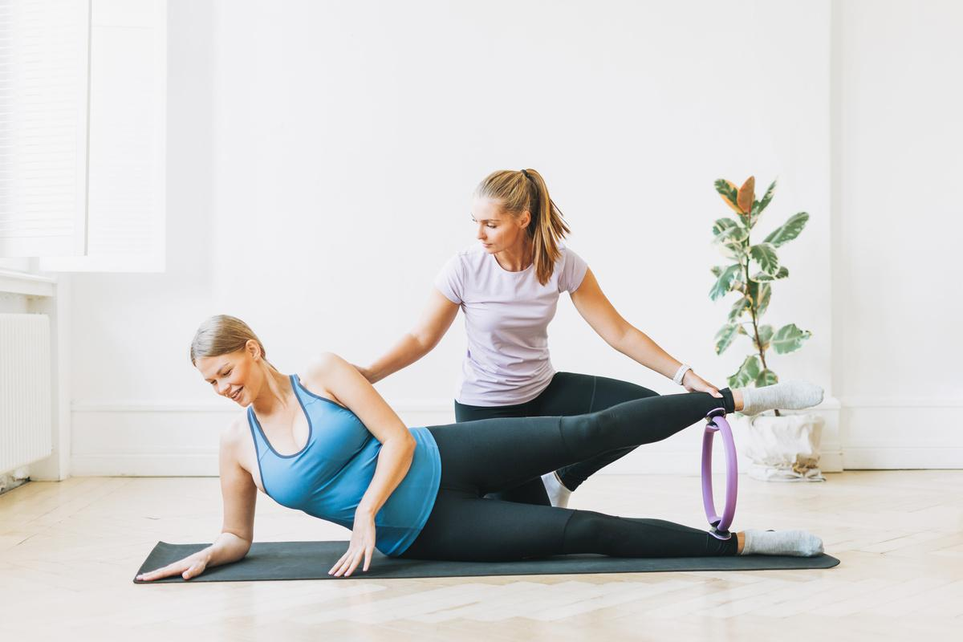
Populations we serve:
YOUR POPULATION HERE.
YOUR POPULATION HERE.
YOUR POPULATION HERE.
Notes:
Add information on some of the populations you focus on serving.

Slide 25

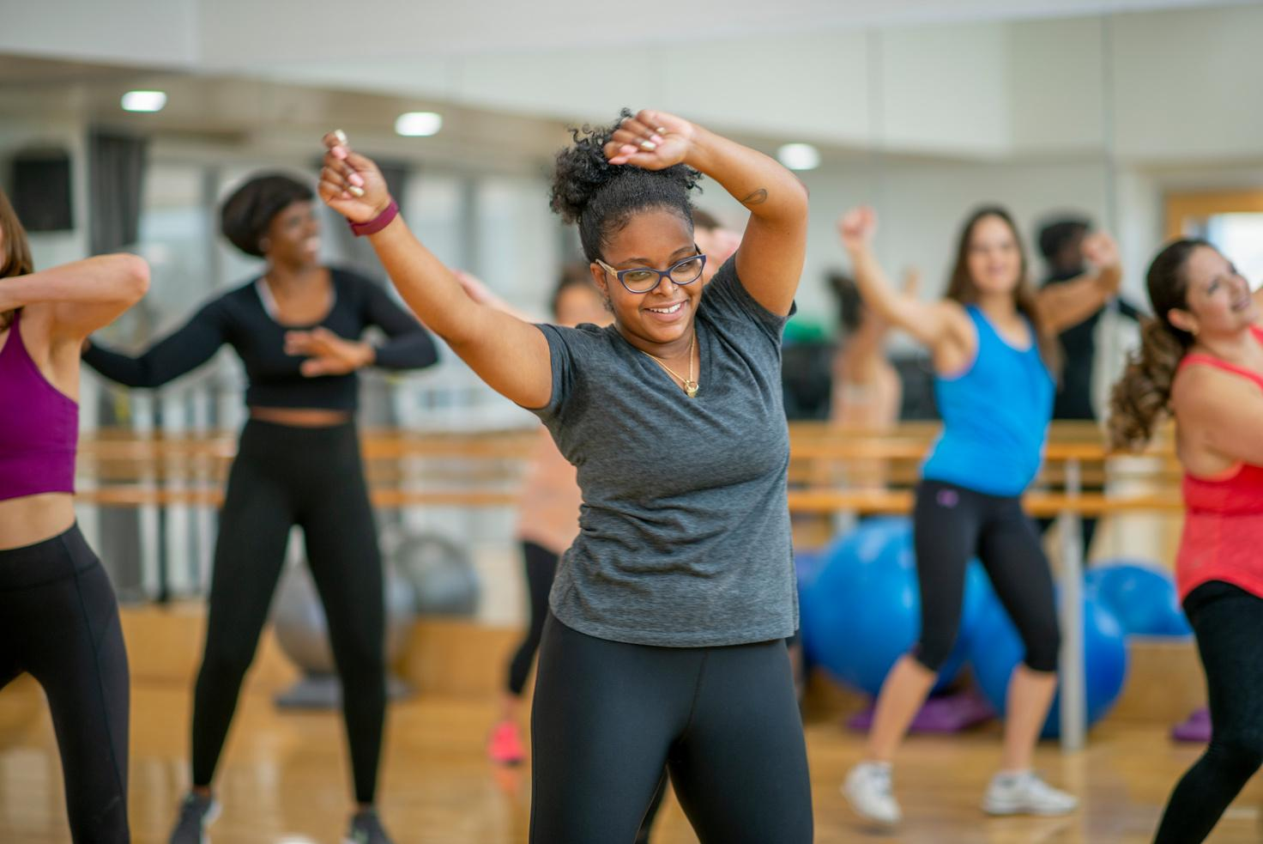

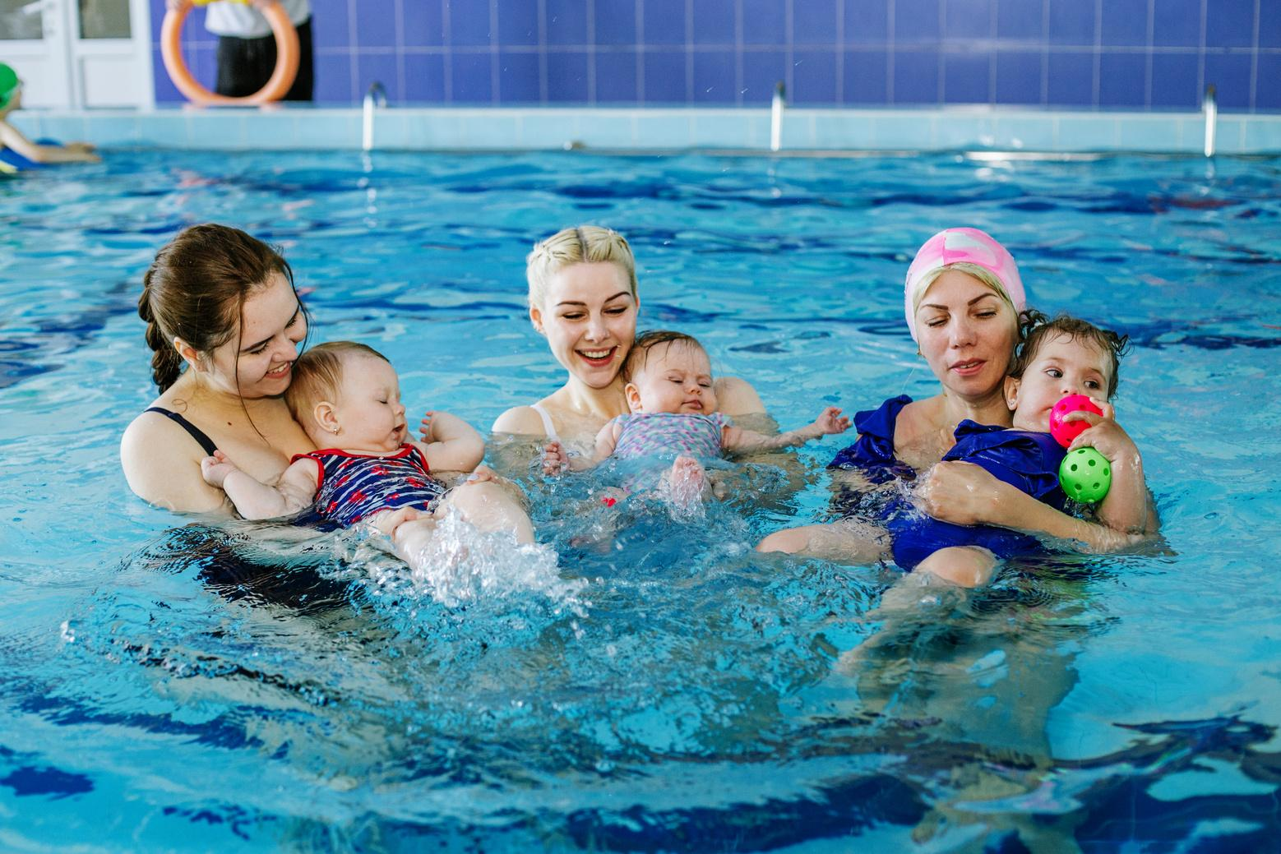
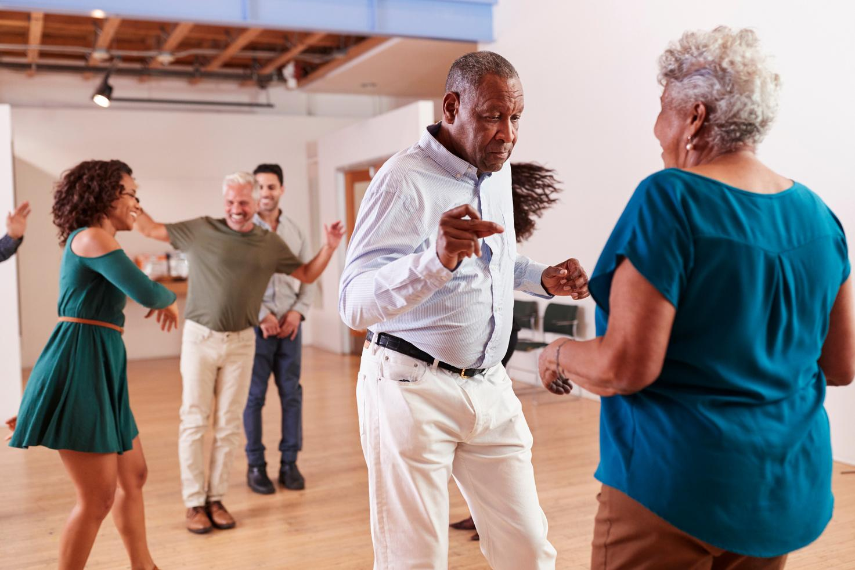

Meet Our Community
Name
Name
Activity
Activity
Name
Name
Activity
Activity
Notes:
This is a place to highlight some of your participants and the ways they engage with parks and recreation.
Before you include their name or a picture, confirm with them that they are okay being included.

Slide 26

Our participants say:
Exercising the body with movements that can maintain body stability and body health is important.
BARTHOLOMEW HENDERSON
Notes:
Insert a quote from one of your participants illustrating the value of their parks and recreation experiences!
If you are not sure whether the person is comfortable with you listing their name, delete the name out.
You can copy this slide if you want to include more than one quote. You can also move it to a different part of the presentation.

Slide 27
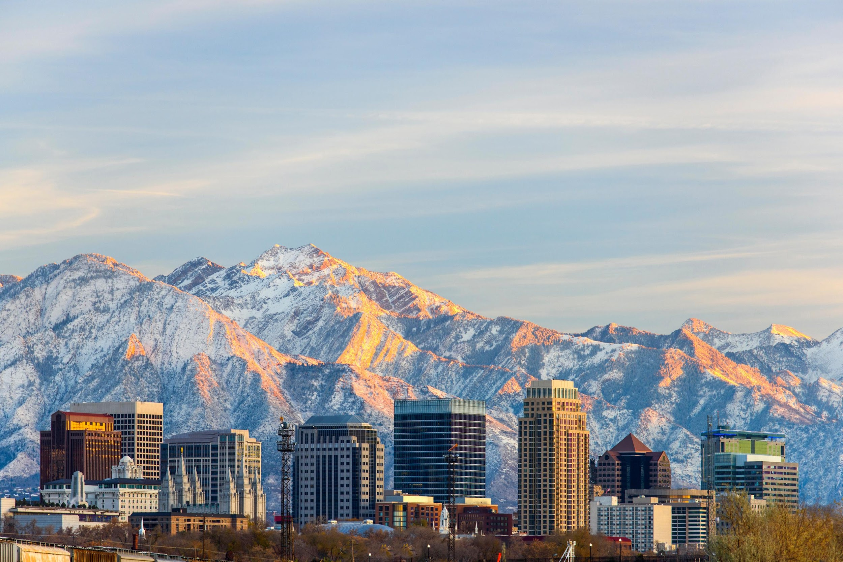




Our Contact
YOUR EMAIL HERE
YOUR WEBSITE HERE
YOUR ADDRESS HERE
Your phone here
Notes:
Add any contact information you want to share.
Delete any contact information you do not want to include.

Slide 28


REFERENCES
Below is an aggregation of references from this slide deck if you would like further information. Additionally, you can find more information and supporting references on the fact sheets available on the URPA Resources Webpage. These fact sheets correspond with the slides in the first half of this deck.
  SAMHSA
  Anderson & Durstine, 2019
  Guthold et al. 2020
  Posadzki et al. 2020
  Warburton, Darren E.R., Bredin, Shannon S.D. 2017
  Bruner et al. 2021
  Howie et al. 2020
  Cronin & Allen 2018
  Bustamante et al. 2022
  Danielsen et al. 2021
  Barragan 2021
  Heckel et al. 2023
  Lackey et al. 2021
  Fagerholm et al. 2021
  Jackson et al. 2021
  Mueller, Park, Mowen 2019
  Sato et al. 2019
  Davies et al. 2019
  Keane et al. 2019
  King et al. 2014
  Davies et al. 2021
  nrpa.org/ParkEconReport
  frpa.org
  nrpa.org
  Community Snapshot Report

